Slide 1

Suitable locations for a new techno club in Brussels
APPlied data science capstone project

Slide 2
19 Brussels' municipalities vs. Friedrichshain
- A data science approach where a clustering algorithm determines which Brussels' district is most similar to nightlife thriving berlin district friedrichshain

Slide 3
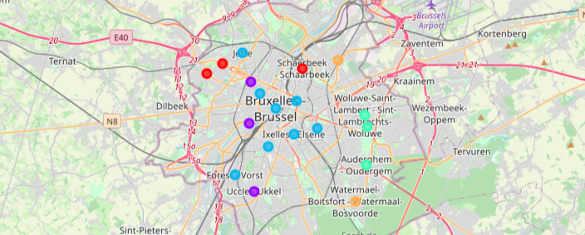
Clusters in Brussel

Slide 4
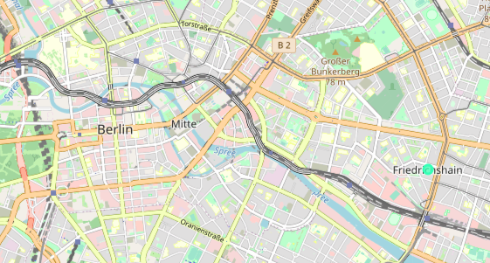
Friedrichshain (blue-green cluster)

Slide 5
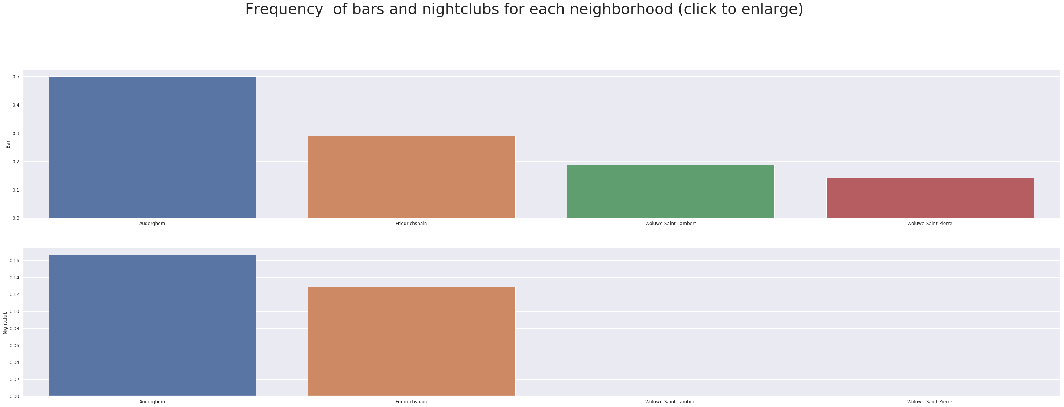
Analysis of cluster 3

Slide 6
Results
The k-means algorithm clusters Friedrichshain together with Woluwe-Saint-Pierre, Woluwe-Saint-Lambert and Auderghem
Woluwe is too residential
Auderghem turns out to be the most favorable district

Slide 7
Conclusion
Auderghem is the most favorable district
Further research needed based on demographic data, regulations and restrictions,…
Foursquare data limited to recommended venues, bigger data set might give different results

Slide 8
Thanks for joining me on my data science trip!
Tom Nel

